Slide 1

Dana Incorporated
Founded in 1904
Based in Maumee, Ohio
2016 sales: $5.8 billion
27,000 people
Global operations and customers
  More than 100 major facilities
  34 countries on six continents
  Customers in 130 countries
16 R&D centers

Slide 2

The Vision Statement
To be the global technology leader in efficient power conveyance and energy management solutions that enable our customers to achieve their sustainability objectives.

Slide 3









Leadership Team
Jim Kamsickas
President &
Chief Executive Officer
Business Units
Legal
Engineering
Purchasing
Bob Pyle
President,
Light Vehicle Driveline
Electrification and
Hybridization
Dwayne Matthews
President,
Power Technologies
Customer Centricity
Doug Liedberg
Senior Vice President,
General Counsel & Secretary
Communications
George Constand
Chief Technical Officer
Core Product/Industrial/
Manufacturing Engineering
Craig Price
Vice President
Purchasing and
Supplier Development
Finance
Human Resources
China
Mark Wallace
EVP and President,
Commercial Vehicle Driveline
Operational Excellence,
Heavy Manufacturing
and Aftermarket
Aziz Aghili
President,
Off-Highway Drive and
Motion Technologies
Brevini Integration
Jonathan Collins
EVP and CFO
Business Development/
Facilities and Real Estate
Mariya Trickett
SVP, Human Resources
Safety and Employee Engagement
Antonio Valencia
Senior Vice President
China and Australia
Revised Sept. 2017
Strategic Leadership Focus

Slide 4








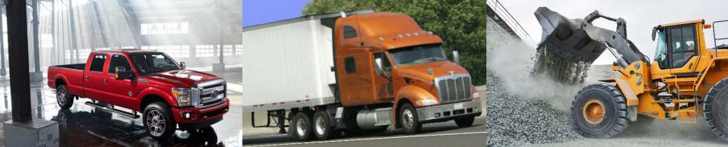

Dana Overview
Business Units
Dana Core Technologies
Vehicle Driveline:
Axles, driveshafts, transmissions, and tire management
Vehicle Engine and Transmission:
Gaskets and seals, transmission separator plates, plastic cam cover and
oil pan modules, heat shields, and fuel cell plates
Vehicle Engine and Transmission:
Transmission and engine oil cooling, battery and electronics cooling,
charge air cooling, and exhaust-gas and heat recovery
Light Vehicle Driveline
Driveline
Technologies
45%
Sealing
Solutions
Commercial Vehicle Driveline 21%
Thermal
Management
End Markets
Off-Highway Drive and Motion
16%
Power Technologies
18%
Light Vehicles
Heavy Vehicles
Off-Highway

Slide 5
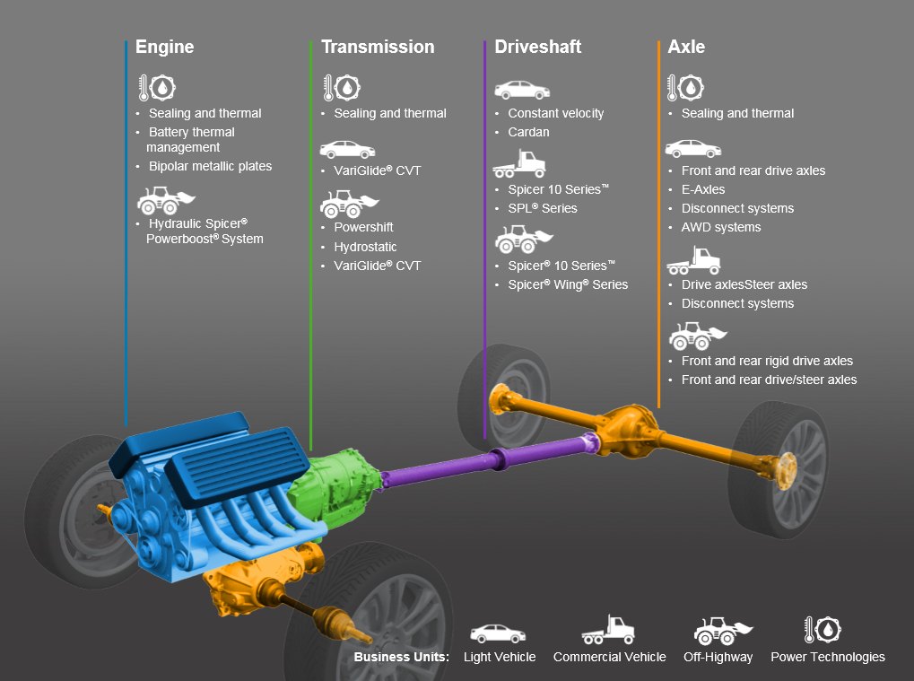
Dana: Integrated Power Solutions

Slide 6
Sales Breakdown
Market
Region
Region
Market
Off-Highway
16%
South America
6%
Light
Vehicles
61%
Asia Pacific
13%
North America
53%
Commercial
Vehicles
23%
Europe
28%
Segment
Customer
Power
Technologies
18%
Ford 22%
FCA* 10%
Light Vehicle
45%
Off-Highway
16%
All Other
Customers 39%
Nissan 6%
PACCAR 5%
GM 4%
Commercial
Vehicle
21%
Toyota 4%
Daimler 2%
Tata/JLR 3%
Ab Volvo 2%
Deere 3%
2016 Sales
* Includes sales to Hyundai Mobis for driveline products that support FCA vehicles

Slide 7
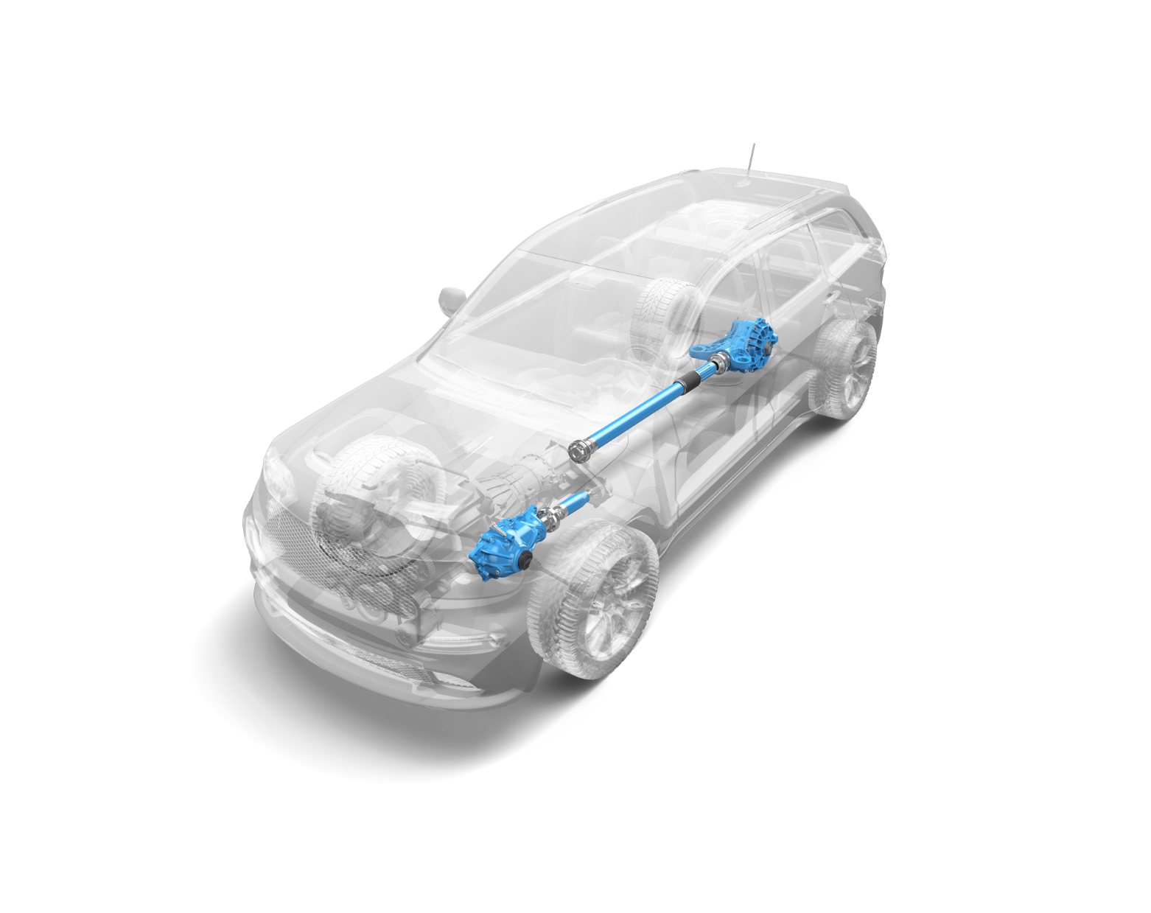
Light Vehicle Products
Axles
Driveshafts
Transmissions
  VariGlide™ Beltless CVT
Thermal
  Engine Oil Coolers
  Active Warm-up Units
  Water-Cooled Charge Air Coolers
  Transmission Oil Coolers
  Fuel Coolers
  Battery Cooling
Sealing
  Cylinder Head Cover Modules
  Cylinder Head Gaskets
  Secondary Gaskets
  Valve Stem Seals
  Thermal Acoustical Protective Shielding
  Thermoplastic Oil Pans
  High-Temperature Gaskets
  Transmission Valve Body Separator Plates

Slide 8
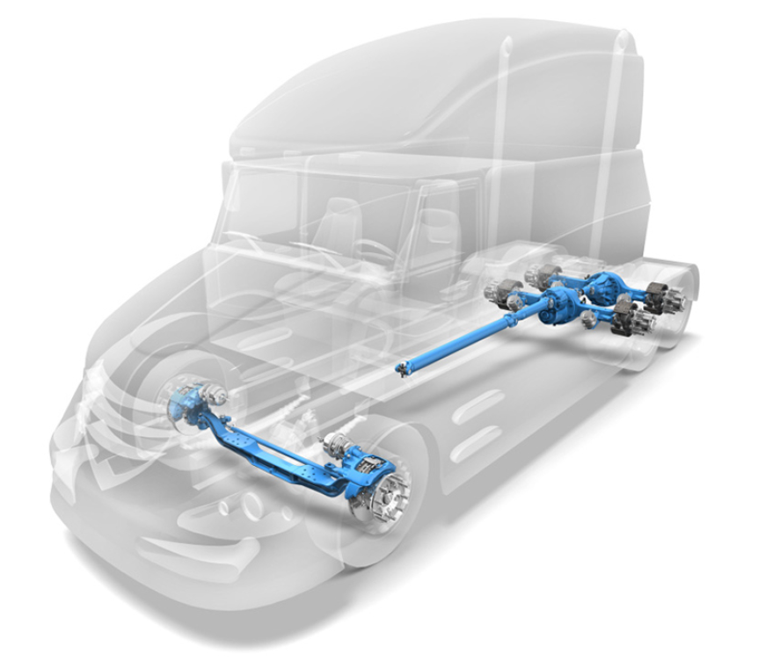
Commercial Vehicle Products
Full Driveline Offering
  Steer Axles
  Drive Axles
  Driveshaft
  Tire Management Systems
Thermal
  Engine Oil Coolers
  Transmission Oil Coolers
  Water-Cooled Charge Air Coolers
Sealing
  Cylinder Head Cover Modules
  Cylinder Head Gaskets
  Secondary Gaskets
  Thermal Acoustical Protective Shielding
  Thermoplastic Oil Pans
  High-Temperature Gaskets
  Valve Stem Seals

Slide 9
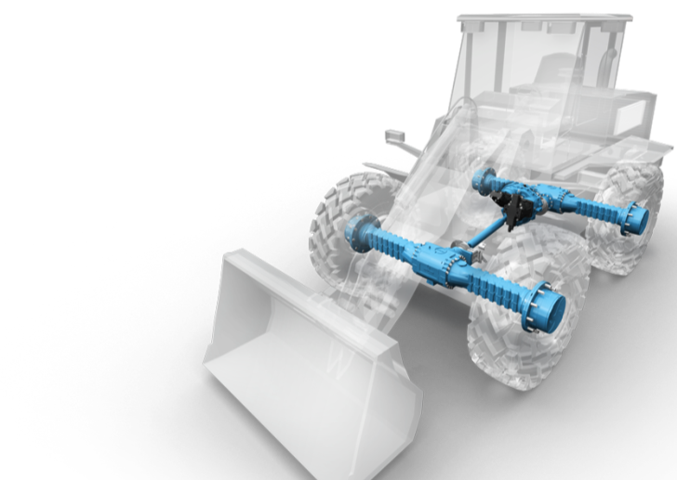
Off-Highway Products
Complete System Offering
  Transmission and Controls
  Axles
  Driveshafts
  Central Tire Inflation Systems
Thermal
  Engine Oil Coolers
  Transmission Oil Coolers
Sealing
  Cylinder Head Cover Modules
  Cylinder Head Gaskets
  Secondary Gaskets
  Valve Stem Seals
  Thermal Acoustical Protective Shielding
  Thermoplastic Oil Pans
  Exhaust Gaskets

Slide 10





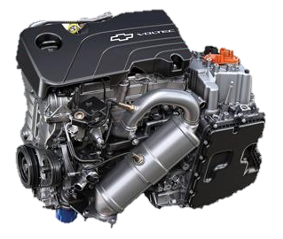
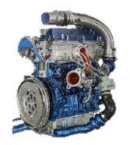
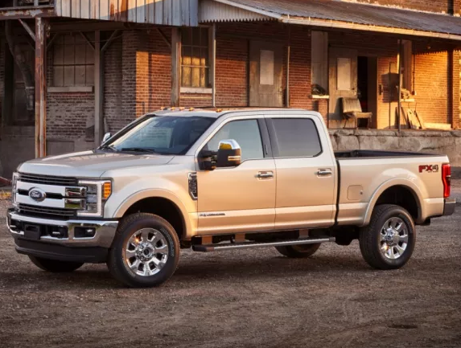



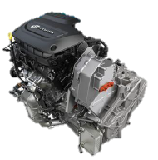
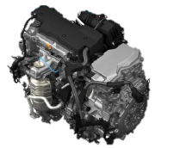

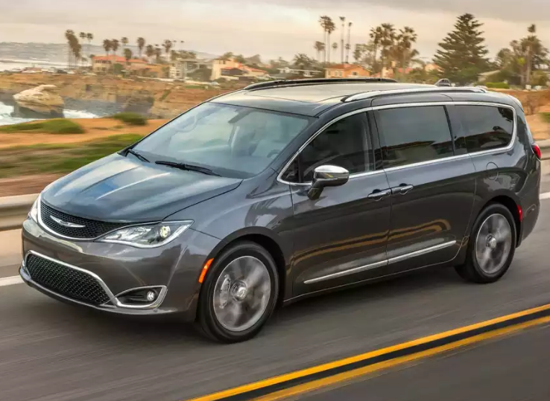


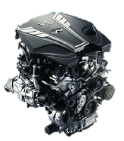
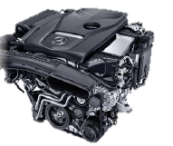
Dana Products Driving Award-Winning Vehicles
Light Vehicle Driveline and Power Technologies
Six of Ward’s 2017
Ten Best Engines
2017 Motor Trend Truck of the Year
2017 North American Truck of the Year
2017 North American Utility Vehicle of the Year

Slide 11




Inorganic Growth
Activity
Strategic Rationale
Business acquisition completed February 2016
Increases penetration in North American aftermarket
Opens new commercial channels for Dana
Enhances key data management and cataloging capabilities
Business acquisition completed December 2016
Secures local supply requirements for Brazilian market
Improves cost structure through vertical integration
Business acquisition completed February 2017
Doubles Off-Highway Driveline addressable market through technology to enter the tracked vehicle space
Significant opportunity to cross-sell Brevini work enabling applications to existing Dana customer base
Delivers $30M of cost synergies in 18-24 months
Business acquisition completed March 2017
Strengthens Dana’s global supply chain
Provides Dana with access to proprietary manufacturing processes and patents

Slide 12


Why Dana?

Slide 13

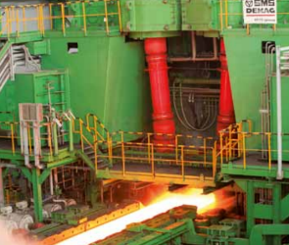
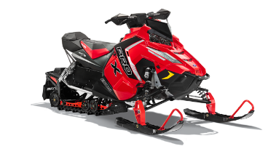
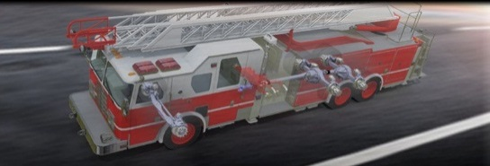
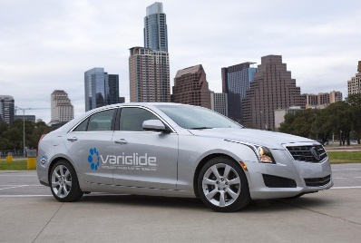

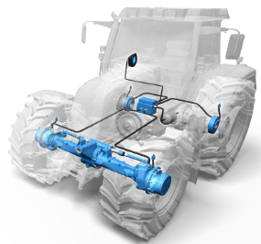
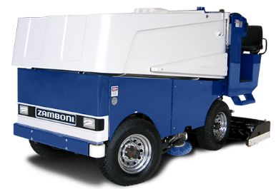
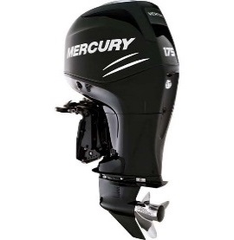

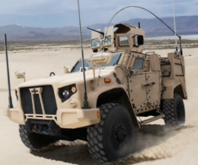

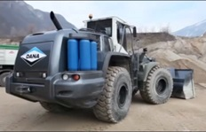


Market Reach

